Slide 1


Slide 2
Chapter 2
Readers and Contexts of Use

Slide 3
Agenda
Profiling Your Readers

Slide 4
Profiling Your Readers
In Technical Communication, Documents Are Designed to Suit the Needs of Specific Types of Readers.
Now you are thinking about building a reader profile for your business proposal what questions will you ask yourself?
Notes:
Reader profiles are sketches of your readers’ tendencies, abilities, experiences, needs, values, and attitudes.

Slide 5
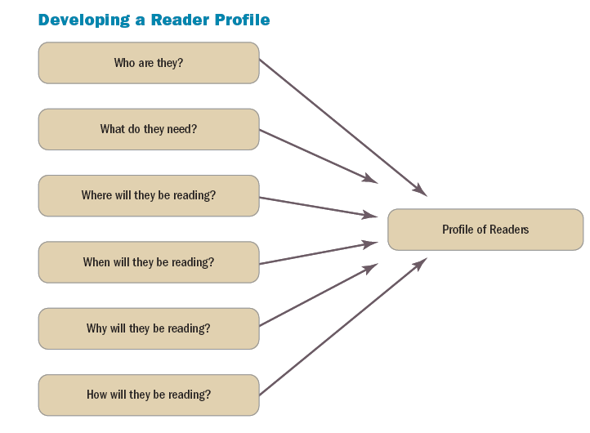

Slide 6
Technical Readers
Raiders for information
“They want to take a decision / an action”
Responsible for interpreting text
“ Technical writers don’t come with the manual to explain.”
want only “need-to-know” information
“Who cares about that extra information?”
Prefer concise texts and with graphics
“ The shorter the better and we need the document to be readable”
Notes:
Readers are raiders for information.
People don’t read technical documents for pleasure. They are raiding the document for information they need to make decisions.
Readers are responsible for interpreting text.
You won’t be able to explain the information, so it is important that readers be able to figure out the information on their own.
Readers want only “need-to-know” information.
Readers don’t want extra information. Extra information makes it harder to find what they need.
Readers prefer concise texts.
The shorter, the better. Get to the point and highlight important information.
Readers prefer documents with graphics and effective page design.
Large blocks of text are intimidating. Graphics and page design make the document more readable.

Slide 7
Identify your Reader !
Primary readers (action takers)
[ addressed to/ decision makers.]
Secondary readers (advisors)
[advise primary ]
Tertiary readers (evaluators)
[anyone else who might be interested]
Gatekeepers (supervisors)
[look over the document before it is sent to primary]
Notes:
Primary Readers (Action Takers)
Primary readers are people to whom the document is addressed. The information you are providing will allow them to make a decision or take action.
Secondary Readers (Advisors)
Secondary readers are people who advise primary readers.
Tertiary Readers (Evaluators)
Tertiary readers may be anyone else who has an interest in your document’s information. Don’t write anything that could put you or your company at risk.
Gatekeepers (Supervisors)
Gatekeepers are people who will need to look over your document before it is sent to the primary readers.

Slide 8
When Profiling Your Readers’ Needs, Values, and Attitudes
Needs [what information does each need?]
Values [What do they value most ? Profit? Environmental or social concerns?]
Attitudes [What is their attitude towards you? Your company? Subject of the document?]
familiarity with the subject
Professional experience
educational level
reading and comprehension level
skill level
Notes:
Needs
What information do your primary readers require to make a decision or take action? What do your secondary readers need to make a positive recommendation? What are tertiary and gatekeeper readers looking for?
Values
What do your readers value most? Efficiency and consistency? Accuracy? Profit? Environmental or social concerns?
Attitudes
What are your readers’ attitudes toward you, your company, and the subject of your document?

Slide 9
An environmental group has an interest in your document about emissions. What kind of an audience is this group?
Primary audience
Secondary audience
Tertiary audience
Gatekeepers

Slide 10
An environmental group has an interest in your document about emissions. What kind of an audience is this group?
Primary audience
Secondary audience
Tertiary audience
Gatekeepers

